Slide 1
Enhancing Platform Competition
Why is this attractive?
Anti-trust, Regulatory, and Fiscal Paths
Pros and cons of specific policy ideas

Slide 2
Why is Platform Competition Good?
What do we mean by competition? Or a well functioning market?
Potential measures, which will not all line up:
High markups above marginal cost, by restricted supply
High profits
Compared to other industries
Compared to the amount of surplus to consumers or connected industries
High concentration in firm sizes (e.g. the HHI-index)
By which of these measures are digital industries monopolies?

Slide 3
High markups above marginal cost
Hard to say:
The marginal cost of an internet search or Facebook scroll is very low, and it is free to consumers, but:
The marginal cost of showing an Ad on Google Search or Instagram is hard to measure, but ad fees are huge when added up

Slide 4
High profits
Compared to other industries
>Yes, these industries have grown very fast and are very profitable for the largest firms”
Compared to the amount of surplus to consumers or connected industries
>Depends on your welfare estimate:
Some estimate place the user benefit split to be 90% vs. 10% platform profit (in social media)
Others estimate the net effect of social media to be negative for welfare

Slide 5
High concentration in firm sizes (e.g. the HHI-index)
Tech has produced some of the largest firms in the world, but also multitudes of smaller firms – a power-law distribution. Somewhat more concentrated
Precise concentration depends on market definition, which is often a main thing contested in anti-trust cases
Is Meta a monopolist in the “social media” industry, or merely a very large player in the advertising industry?

Slide 6
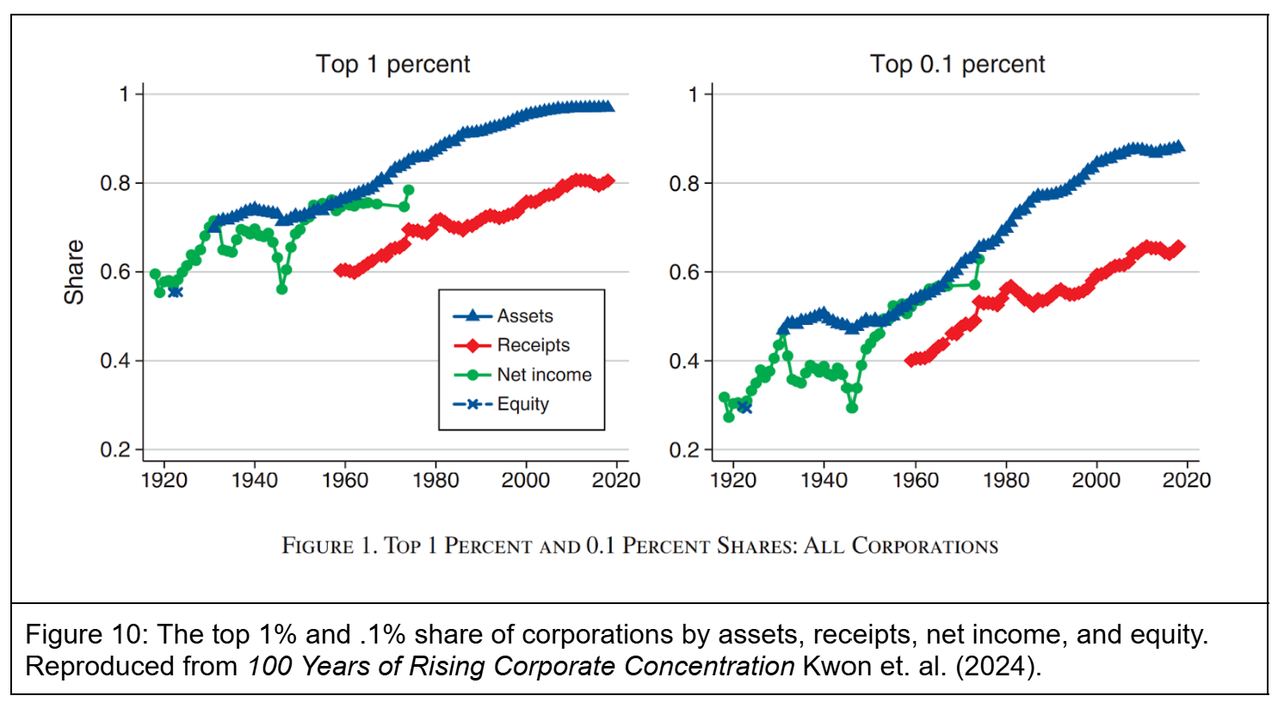
High concentration in firm sizes (e.g. the HHI-index)
Also all firms are more concentrated:

Slide 7
Why Might Digital Platforms Be More Monopolistic?
Professor Morton Identifies:
Network effects (demand side economies of scale)
Supply side economies of scale and
Data network effects – a hybrid of the above
‘Ecosystem business model’ – a network effect as applied to suppliers, e.g. : “If I have a mobile OS, I can stimulate demand for it by providing ( or getting others to provide) a handset, a map, a browser, and an app store and so forth.‌”

Slide 8
If they’re monopolies is that bad?
Traditional economic logic: monopolies undersupply quality/innovation + crush potential competitors to keep prices high. If we had more competition we’d have better, cheaper digital platforms.
Neo-Brandeisian logic: big firms are bad because they manipulate politicians. A mittelstand makes for better, fairer, politics than a country with few big firms.
Austrian-Theil logic: monopoly profits are the entrepreneurs incentive to innovate. If you get rid of profit, you get rid of innovation

Slide 9
If they’re monopolies is that bad?
Traditional economic logic: monopolies undersupply quality/innovation + crush potential competitors to keep prices high. If we had more competition we’d have better, cheaper digital platforms. (do we want that?)
Neo-Brandeisian logic: big firms are bad because they manipulate politicians. A mittelstand makes for better, fairer, politics than a country with few big firms. (is that empirically true?)
Austrian-Theil logic: monopoly profits are the entrepreneur’s incentive to innovate. If you get rid of profit, you get rid of innovation. (Does this outweigh downsides?)

Slide 10
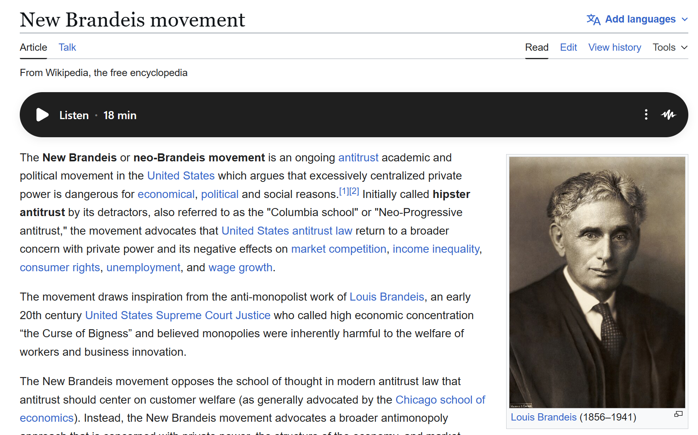

Slide 11
Three Potential Paths
Anti-trust
Laws + Regulators
Fiscal policy (taxes and subsidies)

Slide 12
Three Potential Paths
Anti-trust
Difficult path:
In the US based on the Sherman Anti-Trust AcT
Need for a “smoking gun” of anti-competitive behavior
(how will AI change this?)
Investigations of particular companies may appear politically motivated
Need for a “remedy” based on the “rule of reason”

Slide 13
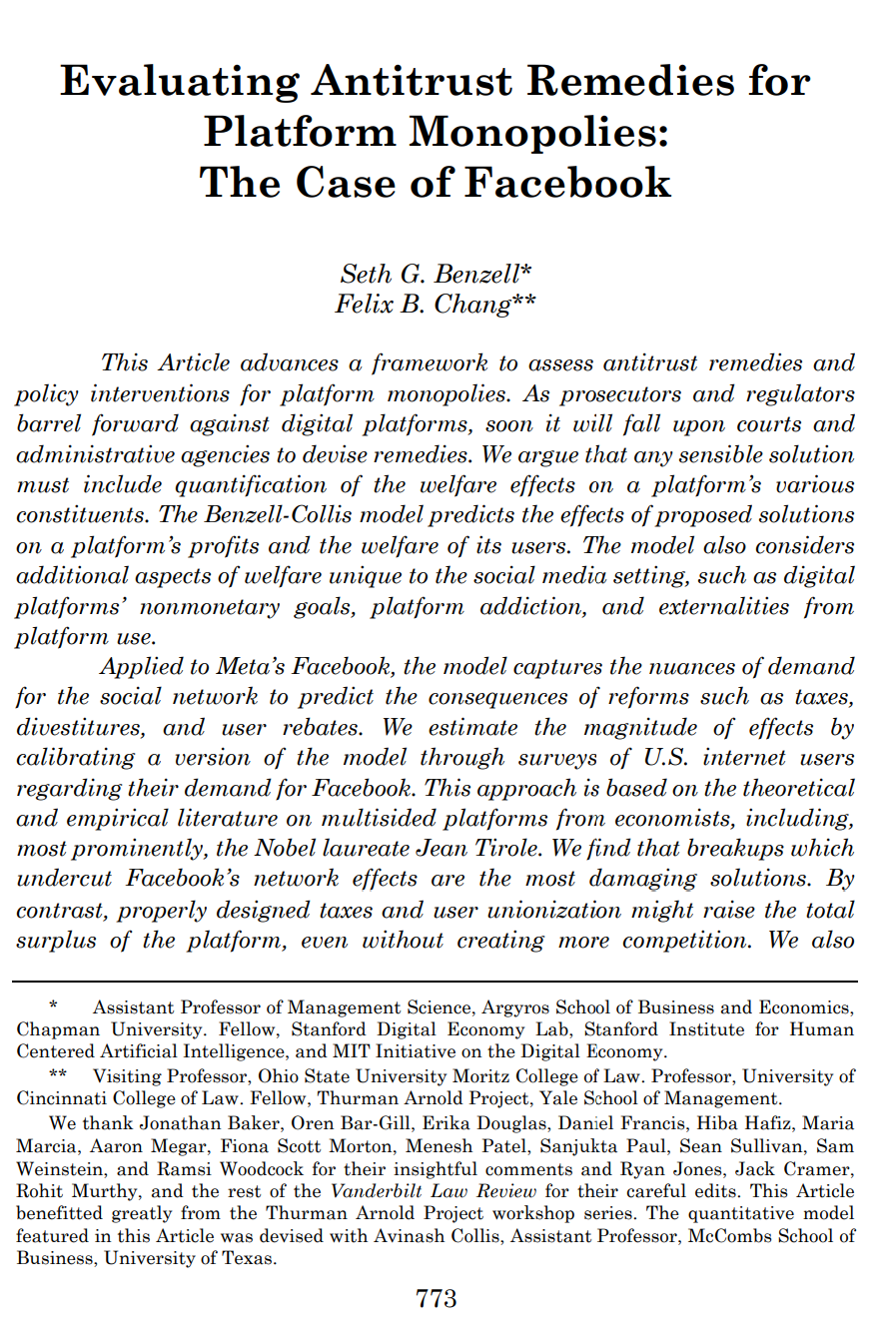
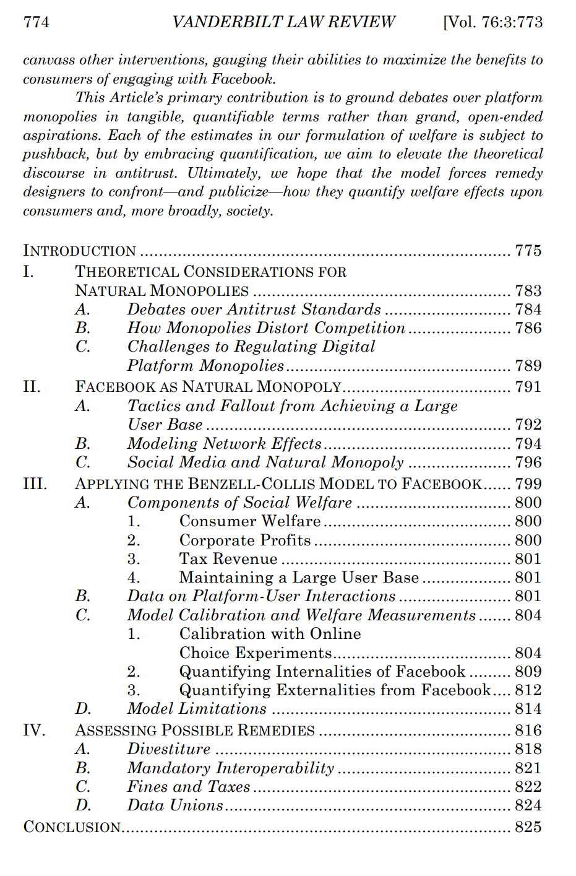

Slide 14
Three Potential Paths
Laws and Regulations:
Lots of theory about what would be good:
Data portability rules to break moats from digital network effects
Other boosts to entry + small firms on platforms
Although some counterintuitive results too:
If social media is bad for you, we should want it to be less competitive
Many small competitive platforms may provide less social value than one ‘natural’ monopolists
Regulators may make rules too slow
Platforms have huge bargaining power to prevent laws they don’t like

Slide 15
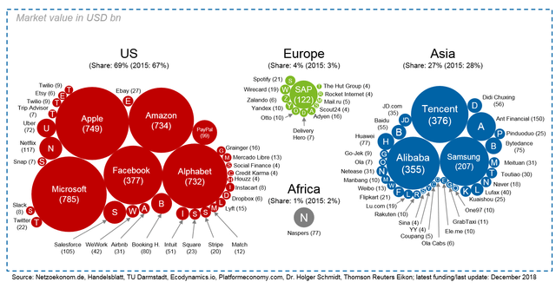
Some research suggests GDPR and other EU regs discouraged big platforms

Slide 16
Fiscal Policy:
If platforms are a ‘natural monopoly’ there still might be things to do:
If your concern is just that platforms get an unfair share of the value they create (profit too high) you could tax and transfer
If your concern is that platforms are bad for people you can add a “sin tax”
You might also find ways to subsidize the entry of competitors
Competition “for” the market vs. competition “in” the market in

